Slide 1


It's “fun until”
Notes:
Susan – Co-branded with DII logo (Alll Three of us are working on this title – 7/25/24)
Dr. Norman – wanted to use this title
TITLE Dr. Susan wanted: Fentanyl & The Poisoning of Our Children.
Norman Robbie Susan – include some news clippings using this link - https://tv.youtube.com/watch/8cDM3lFUavU?vpp=6gEWCMCd964GENw4Ggs2NXd2N0w3WTVWNIACw
J33rgY%3D&amp;vp=0gEiChYIwJ33rgYQ3DgaCzY1d3Y3TDdZNVY0EgIwAhjAnfeuBg%3D%3D
*I do not have a youtube tv account, but there is a free clip of the pill making process on: https://www.youtube.com/watch?v=jNfSPdwTQ14

Slide 2

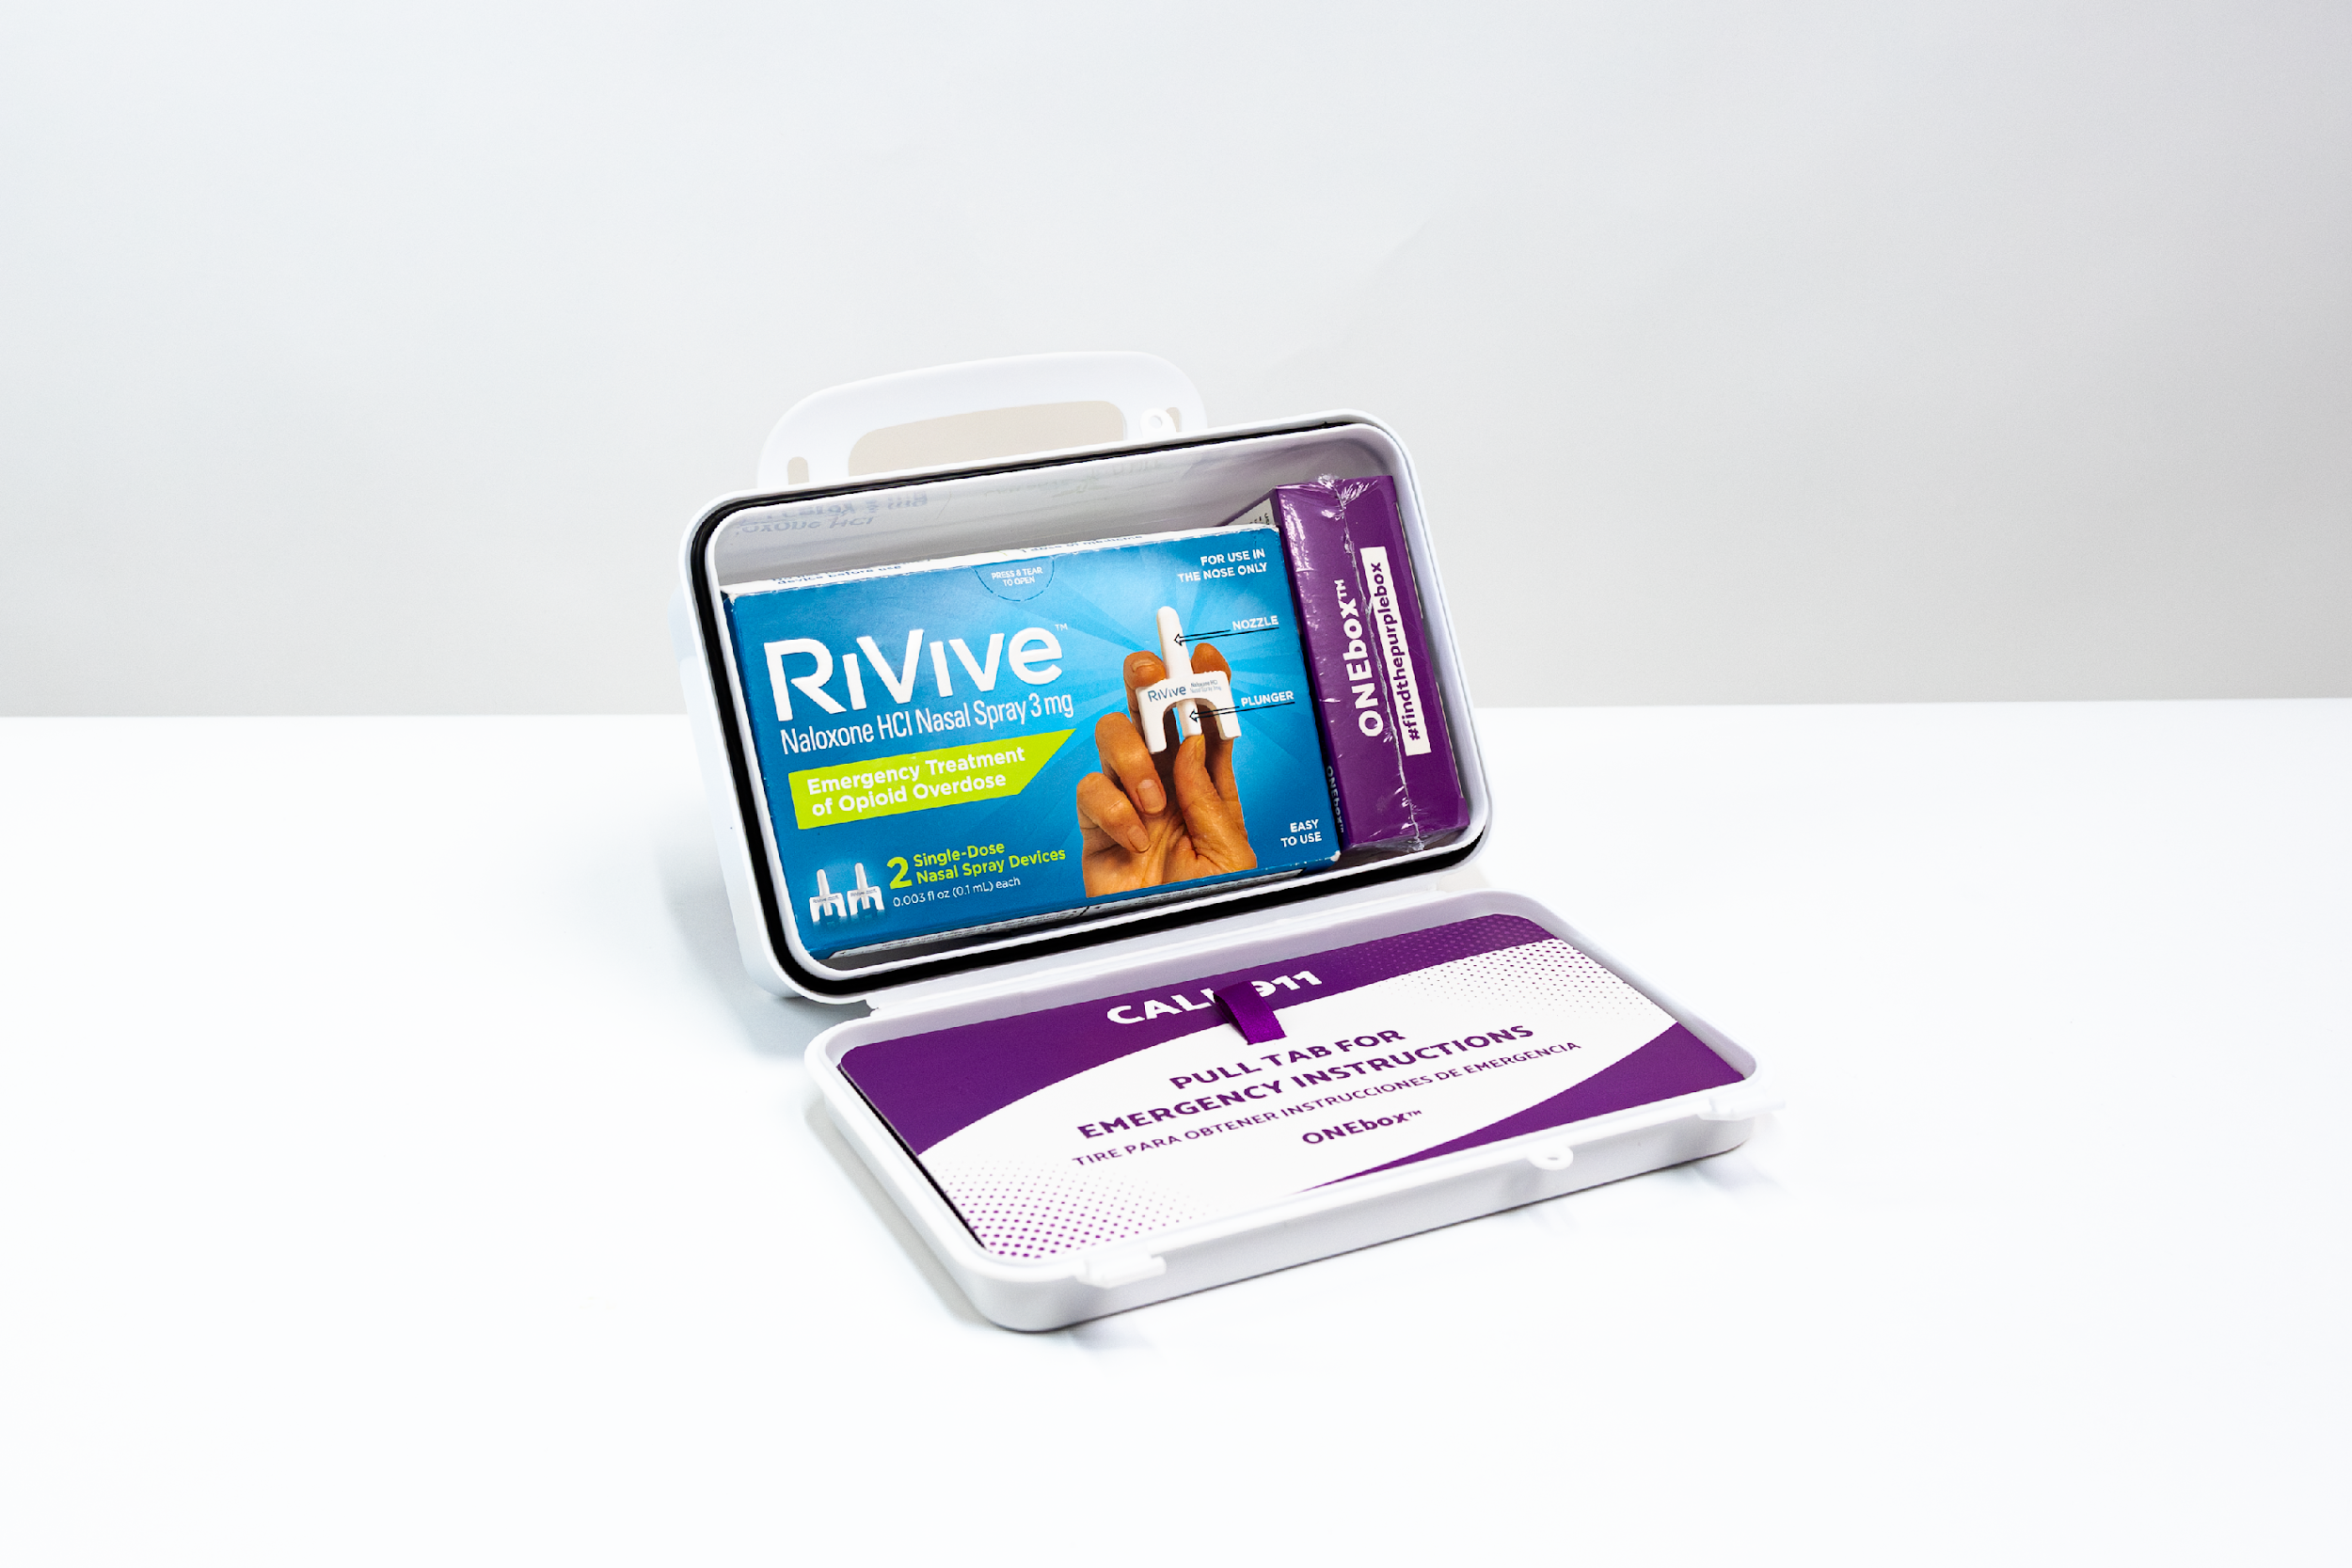
Overview
Lethality & Risk
  Substance was not received from a Pharmacist:
    Real or contaminated
Drug overdose death rate
  National vs West Virginia
You can test your substance
What to do if you find it
Notes:
Susan – Co-branded with DII logo (Alll Three of us are working on this title – 7/25/24)
Dr. Norman – wanted to use this title
TITLE Dr. Susan wanted: Fentanyl & The Poisoning of Our Children.
Norman Robbie Susan – include some news clippings using this link - https://tv.youtube.com/watch/8cDM3lFUavU?vpp=6gEWCMCd964GENw4Ggs2NXd2N0w3WTVWNIACw
J33rgY%3D&amp;vp=0gEiChYIwJ33rgYQ3DgaCzY1d3Y3TDdZNVY0EgIwAhjAnfeuBg%3D%3D
*I do not have a youtube tv account, but there is a free clip of the pill making process on: https://www.youtube.com/watch?v=jNfSPdwTQ14

Slide 3
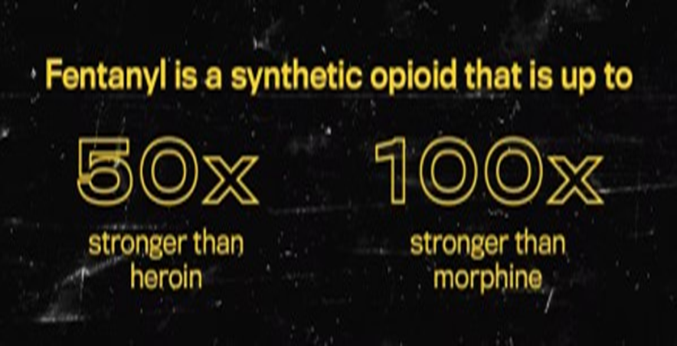
Lethality & Risk
Fentanyl is the “Heroin of Today”
It’s a potent synthetic opioid drug approved by the FDA for use as an analgesic (pain relief) & anesthetic
13.5% of overdose deaths are persons aged 15 to 24.
FENTANYL is now the #1 cause of death for Americans aged 18 to 45
Fentanyl deaths among teens tripled in just 2 years, with a 5-fold increase among black teens in that same period
Notes:
Susan – Co-branded with DII logo (Alll Three of us are working on this title – 7/25/24)
Dr. Norman – wanted to use this title
TITLE Dr. Susan wanted: Fentanyl & The Poisoning of Our Children.
Norman Robbie Susan – include some news clippings using this link - https://tv.youtube.com/watch/8cDM3lFUavU?vpp=6gEWCMCd964GENw4Ggs2NXd2N0w3WTVWNIACw
J33rgY%3D&amp;vp=0gEiChYIwJ33rgYQ3DgaCzY1d3Y3TDdZNVY0EgIwAhjAnfeuBg%3D%3D
*I do not have a youtube tv account, but there is a free clip of the pill making process on: https://www.youtube.com/watch?v=jNfSPdwTQ14
Star: Cole Stiltner: couldn’t find where the data was collected, I did find from NCDAS reported that in 2023, for every 100,000 people between the age of 15-24 in the US, average of 13.5 people die from an overdose (https://www.cdc.gov/nchs/products/databriefs/db522.htm)

Slide 4
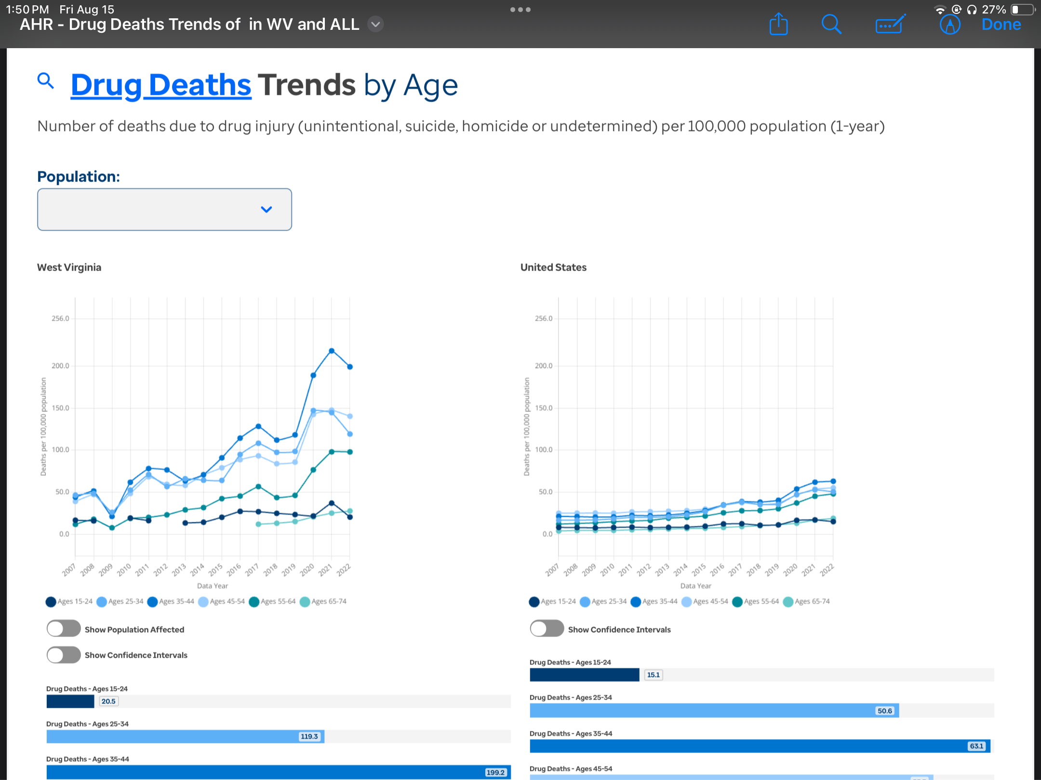
Mortality: WV vs. USA
November 2023-ONE high school in Virginia experienced 8 opioid overdoses in three weeks
Explore Overall in West Virginia." America's Health Rankings, United Health Foundation, 2025, www.americashealthrankings.org/explore/measures/Overall/WV.

Slide 5
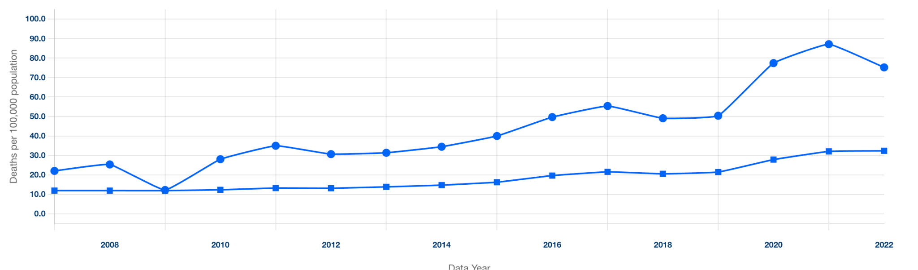
Drug Death Trends
Number of deaths due to drug injury (unintentional, suicide, homicide or undetermined) per 100,000 population (1-year)

Slide 6
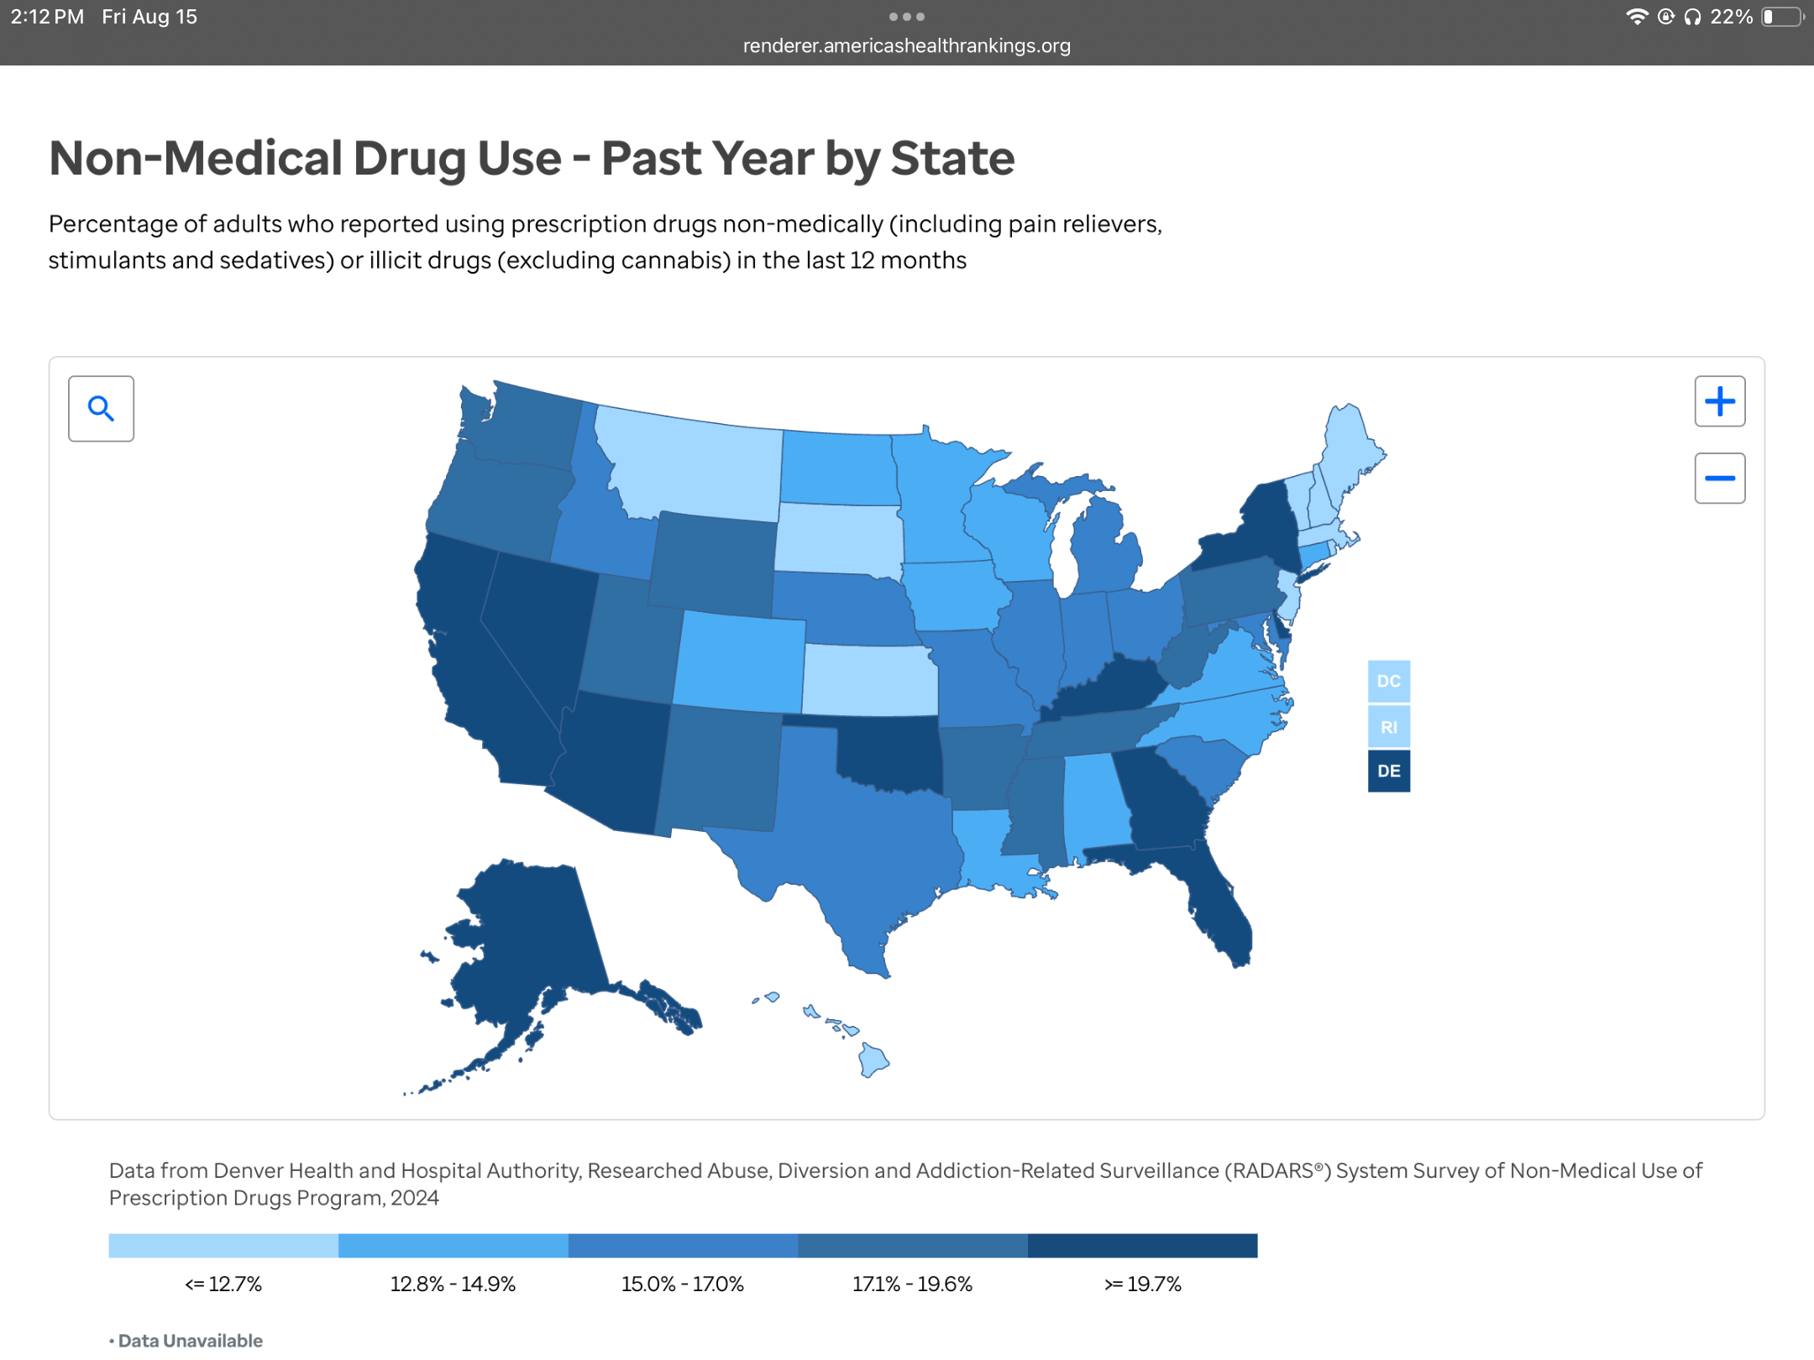
Non-Medical Drug Use: Past Year by State
Top States | Rank | Value
New Hampshire | 1 | 7.4%
Maine | 3 | 9.7%
South Dakota | 4 | 10.8%
Your State | Rank | Value
Wyoming | 39 | 19.2%
West Virginia | 40 | 19.6%
Oklahoma | 41 | 19.7%
Bottom States | Rank | Value
New York | 48 | 22.6%
Delaware | 49 | 22.7%
Nevada | 50 | 39.3%

Slide 7

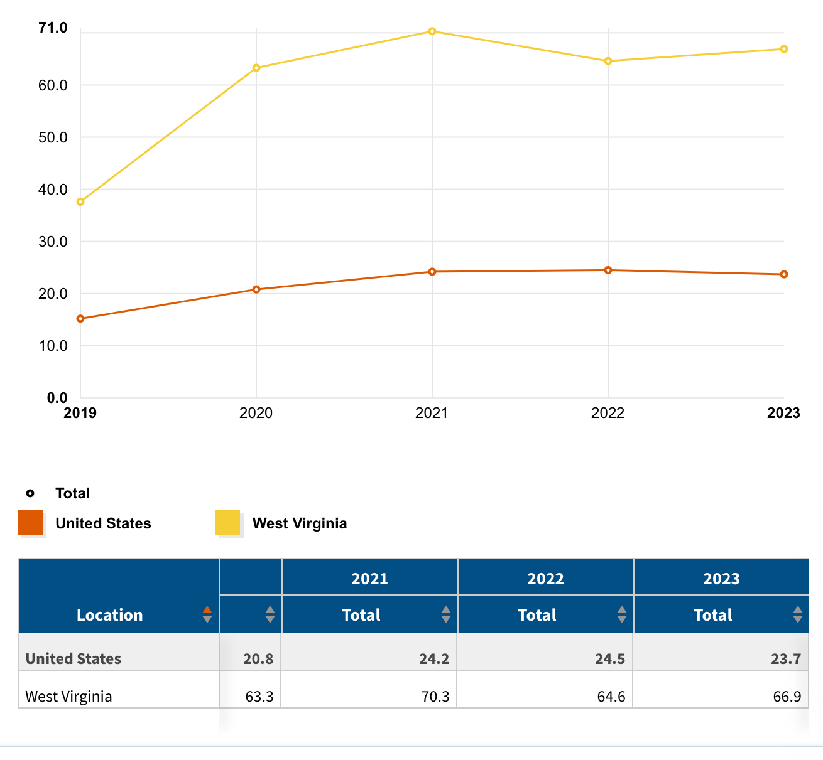
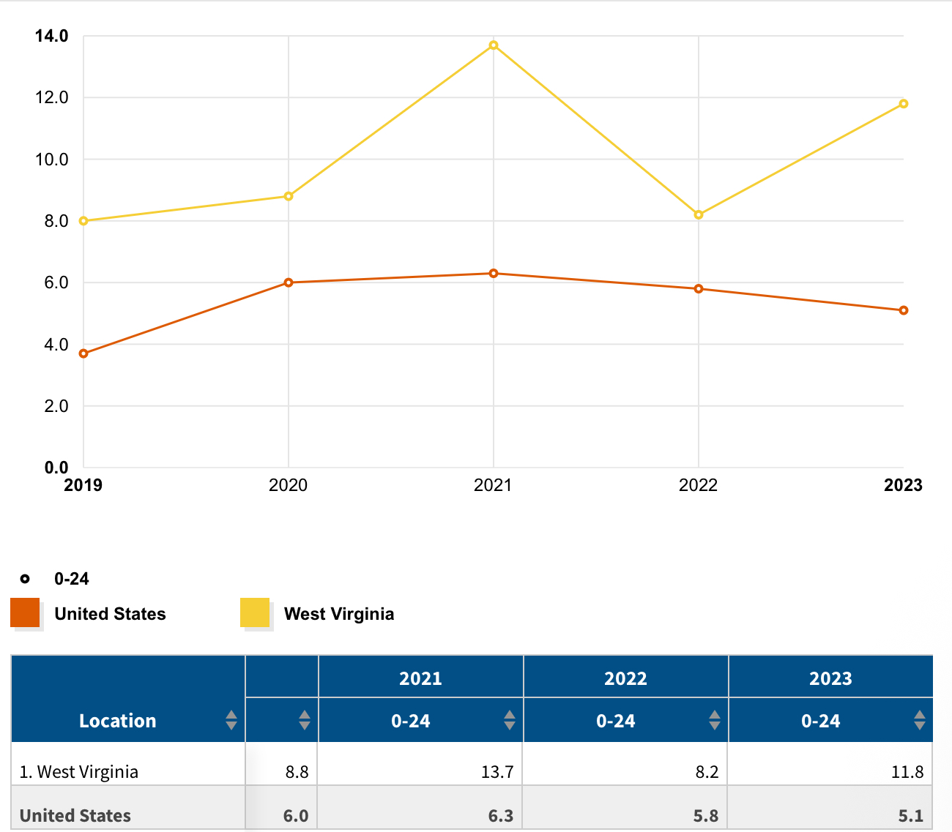
West Virginia vs. National Drug Overdose & Age-Adjusted Death Rate
Drug overdose death rates have increased in West Virginia from 37.6 per 100,000 in 2019 to 66.9 per 100,000 in 2023. Over the same period, drug overdose death rates increased from 15.2 to 20.8 per 100,000 in the U.S (KFF)
Ages (0-24) death rate due to opioid overdose increased from 8.0 per 100,000 to 11.8 per 100,000 in West Virginia. Over the same period, the age-adjusted death rate increased from 3.7 per 100,000 to 5.1per 100,000 in the U.S. (KFF)
Ages (25-34) death rate due to opioid overdose increased from 86.9 per 100,000 to 124.7 per 100,000 in West Virginia. Over the same period, the age-adjusted death rate increased from 29.0 per 100,000 to 38.6per 100,000 in the U.S. (KFF)
Opioid overdose death rates and all drug overdose death rates per 100,000 population (age-adjusted): KFF State Health Facts. KFF. (2025, August 9). https://www.kff.org/mental-health/state-indicator/opioid-overdose-death-rates/?activeTab=graph&currentTimeframe=0&startTimeframe=4&selectedRows=%7B%22states%22%3A%7B%22west-virginia%22%3A%7B%7D%7D%2C%22wrapups%22%3A%7B%22united-states%22%3A%7B%7D%7D%7D&sortModel=%7B%22colId%22%3A%22Location%22%2C%22sort%22%3A%22asc%22%7D - Accessed August 13th, 2025
Notes:
We combined graphs & info/SLIDES – filler slide as Norman called it – allowing him or someone to adlib
Cole Stiltner: Source for data: https://www.kff.org/mental-health/state-indicator/opioid-overdose-death-rates/?activeTab=graph&currentTimeframe=0&startTimeframe=4&selectedRows=%7B%22states%22:%7B%22west-virginia%22:%7B%7D%7D,%22wrapups%22:%7B%22united-states%22:%7B%7D%7D%7D&sortModel=%7B%22colId%22:%22Location%22,%22sort%22:%22asc%22%7D
** Add in accessed date Aug 13th 2025 **

Slide 8

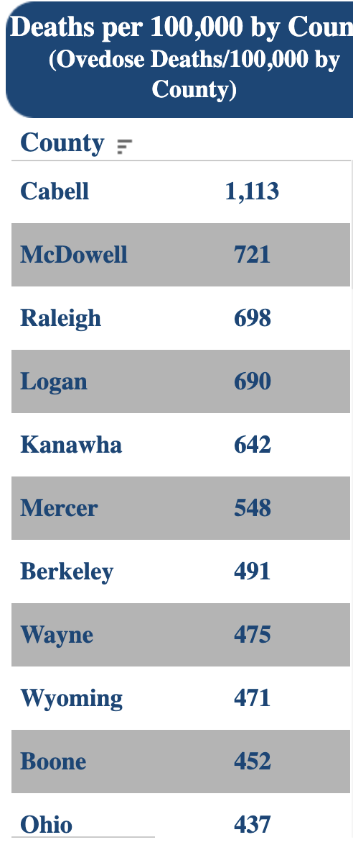
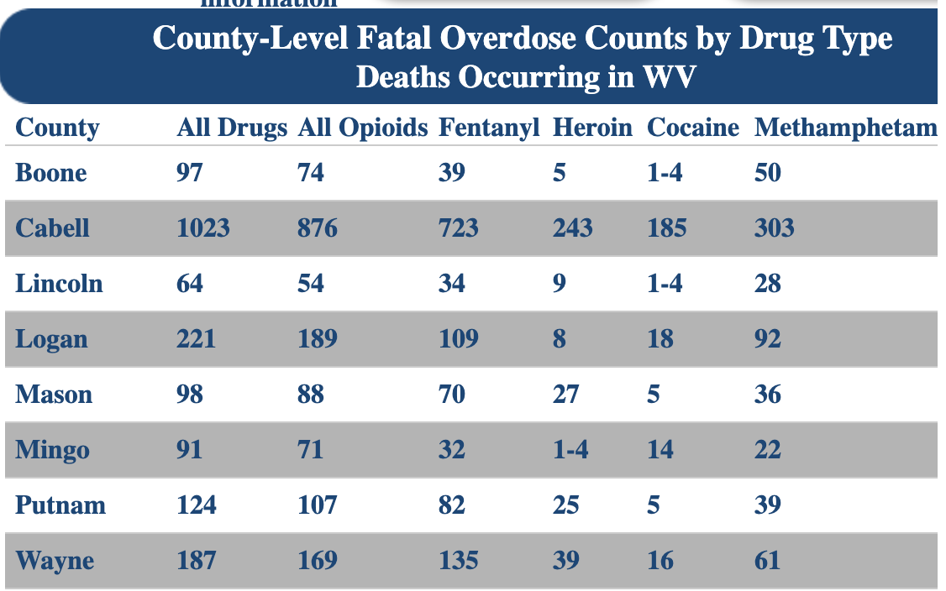
WV Overdose Data: 2015-2021
West Virginia Department of Health and Human Resources. "Data Dashboard." Office of Drug Control Policy, https://odcp.wv.gov/
Notes:
I found this graph on the state website dashboard for od health human services and used the snipping tools to get the West Virginia – Value and relation
Source: https://dhhr.wv.gov/office-of-drug-control-policy/datadashboard/Pages/default.aspx
West Virginia Department of Health and Human Resources. "Data Dashboard." Office of Drug Control Policy, https://dhhr.wv.gov/office-of-drug-control-policy/datadashboard/Pages/default.aspx. Accessed 12 July 2024.
ADD title of timeline 2015 – 2021 - multiple age groups – preliminary data -
MACY: Updated data not available on a county level due to lack of reporting

Slide 9

Does My Child Use Drugs?
The percentage of adolescents reporting they used any illicit substances (other than marijuana) in 2024 continued to hold steady below the pre-pandemic levels reported in 2020. (NIDA)
3.4% of eighth graders
4.4 of 10th graders
6.5% of 12th graders
2024 United States National Survey on Drug Use and Health (NSDUH): 48.4 million (16.8%) Americans (aged 12 and older) battled a substance use disorder in the past year
https://nida.nih.gov/news-events/news-releases/2024/12/reported-use-of-most-drugs-among-adolescents-remained-low-in-2024
Notes:
Could we get this in bold & RED, but he would like the bullet info to come in as he is talking with (animation from clicking a mouse)
WVDII Brand/Logo
When the slide appears please have %’s pop up when clicking (the %’s in only in red)

Slide 10
First Use
What is the average age at which kids begin using drugs and/or alcohol in the U.S.?
11-13
However, kids can hide their use for an average of two years before parents notice a problem.
National Center on Addiction & Substance Abuse - Columbia University. Understanding the Influence. Not MY kid. Retrieved June 24, 2024, from https://notmykid.org/wp-content/uploads/2022/03/Substance-Use-Parent-1.25.22.pdf
Notes:
WVDII Brand/LOGO (Could we have animation or would you want the info portrayed)
Source:
CASA Columbia (n.d.). Understanding the Influence. Not MY kid. Retrieved June 24, 2024, from https://notmykid.org/wp-content/uploads/2022/03/Substance-Use-Parent-1.25.22.pdf

Slide 11
First Use & Addiction Risk
What percentage of people who later become addicted begin smoking, drinking, or using drugs before age 18?
90%
National Center on Addiction & Substance Abuse - Columbia University. Understanding the Influence. Not MY kid. Retrieved June 24, 2024, from https://notmykid.org/wp-content/uploads/2022/03/Substance-Use-Parent-1.25.22.pdf
Notes:
WVDII Brand/LOGO (Could we have animation or would you want the info portrayed)
Source:
CASA Columbia (n.d.). Understanding the Influence. Not MY kid. Retrieved June 24, 2024, from https://notmykid.org/wp-content/uploads/2022/03/Substance-Use-Parent-1.25.22.pdf

Slide 12
Would Your Child Use Drugs to Cope with Stress?
What percentage of parents believe their child would use drugs in order to cope with stress?
What percentage of teens using drugs attributed their drug use to coping with stress?
< 10%
Only 7% of parents believe their child would use drugs in order to cope with stress
70%
73% of teens attributed their drug use to coping with stress
National Center on Addiction & Substance Abuse - Columbia University. Understanding the Influence. Not MY kid. Retrieved June 24, 2024, from https://notmykid.org/wp-content/uploads/2022/03/Substance-Use-Parent-1.25.22.pdf
Notes:
WVDII Brand/LOGO (Could we have animation or would you want the info portrayed)
Source:
CASA Columbia (n.d.). Understanding the Influence. Not MY kid. Retrieved June 24, 2024, from https://notmykid.org/wp-content/uploads/2022/03/Substance-Use-Parent-1.25.22.pdf

Slide 13
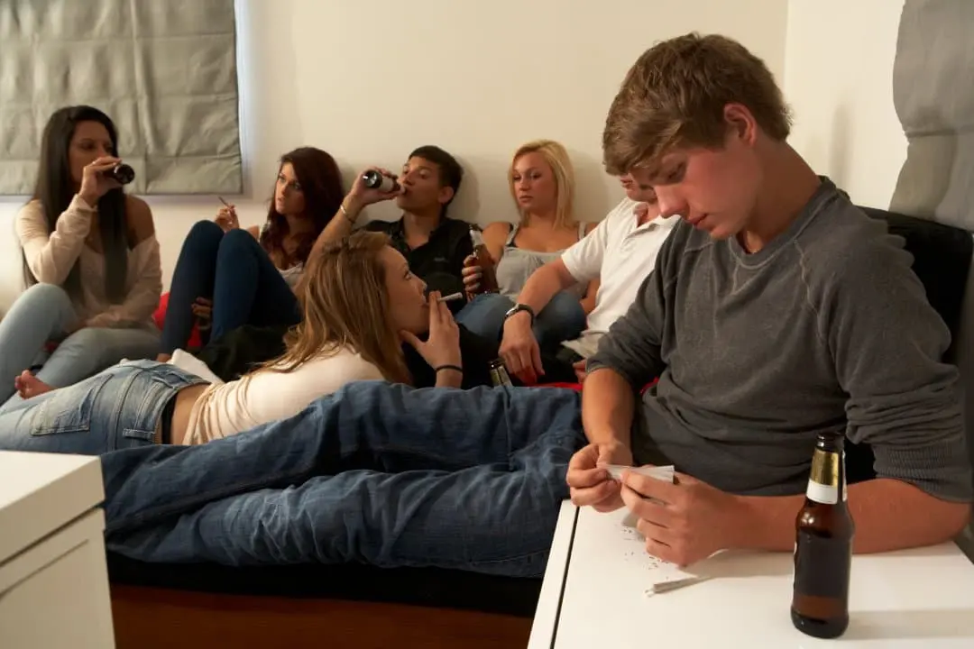
Why Do Kids Use Drugs?
Bullying
Peer Pressure or Trying to look cool
Family Dynamic
Social Media or Pop Culture Influence
School culture
Availability
Boredom
Curiosity
Environmental Factors
Feel Better
            National Center on Addiction & Substance Abuse - Columbia University. Understanding the Influence. Not MY kid. Retrieved June 24, 2024, from https://notmykid.org/wp-content/uploads/2022/03/Substance-Use-Parent-1.25.22.pdf
Notes:
CO/Brand with WVDII (WVDII INFO & Norman & I found this on notmykid.org & thought it was useful
July 2024 – please add your reference for info - CASA Columbia (n.d.). Understanding the Influence. Not MY kid. Retrieved June 24, 2024, from https://notmykid.org/wp-content/uploads/2022/03/Substance-Use-Parent-1.25.22.pdf

Slide 14
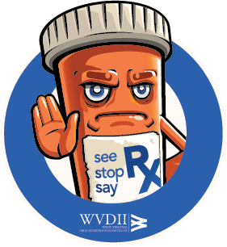
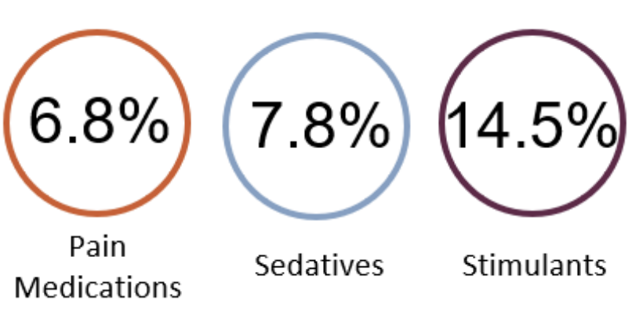
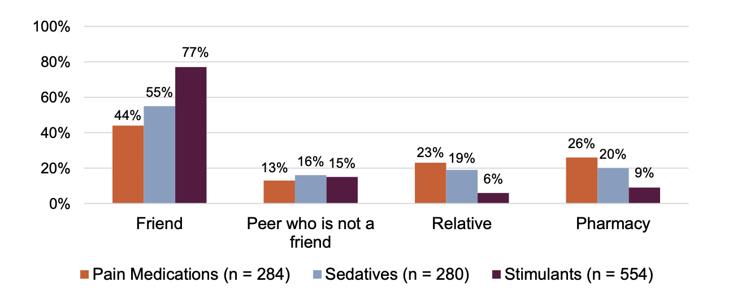
College & Misusing Rx Drugs
By the time children reach college, sharing and misusing prescription drugs for non-medical purposes has become normalized. However, opioids aren’t the only problem.
Baker, Emily A. & Miracle, Tessa L. (2022). College Prescription Drug Study Key Findings Report. College of Pharmacy, The Ohio State University: Columbus, Ohio
Notes:
Found this info in WVDII resources - we can transition to Rex the rx or other WVDII tools – July 24 but also this is great area to talk about counterfeit medication that is not from a pharmacy

Slide 15
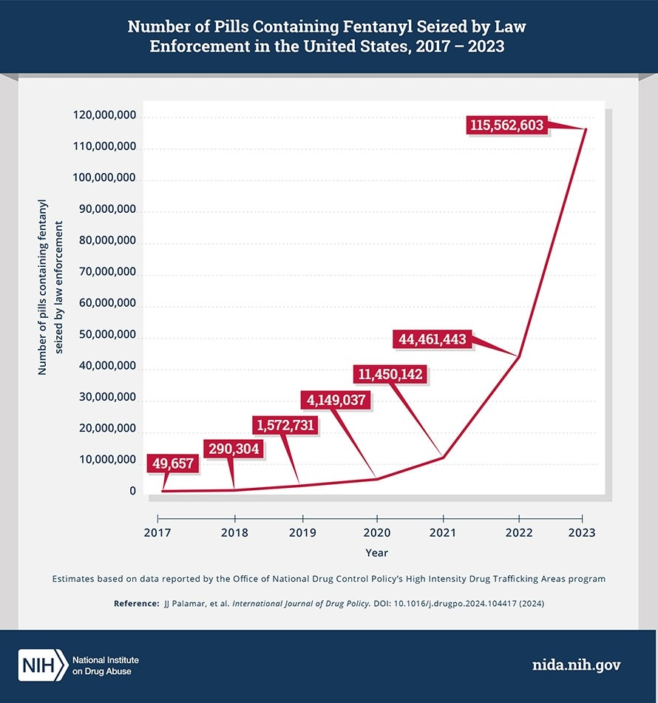
Number of Pills Containing Fentanyl Seized by Law Enforcement in the US, 2017-2023
Notes:
WHAT DO YOU DO IF YOU FIND IT. Wanted to let parents know HOW MUCH FENT is in the Drug supply currently
70% of Fake Drugs have often been found to contain a lethal dose of fentanyl. - place on left of curve in the white area Over 115 Million Pills Containing Illicit Fentanyl Seized by Law Enforcement in 2023." National Institutes of Health, U.S. Department of Health and Human Services, 13 May 2024, https://www.nih.gov/news-events/news-releases/over-115-million-pills-containing-illicit-fentanyl-seized-law-enforcement-2023
MACY: https://www.dea.gov/resources/facts-about-fentanyl

Slide 16
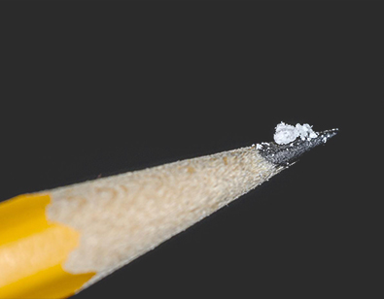
A Lethal Dose
As of 2024- 42% of pills tested for fentanyl contained at least 2 mg of fentanyl, considered a potentially lethal dose.
Notes:
Found this info in WVDII resources - we can transition to Rex the rx or other WVDII tools – July 24 but also this is great area to talk about counterfeit medication that is not from a pharmacy

Slide 17
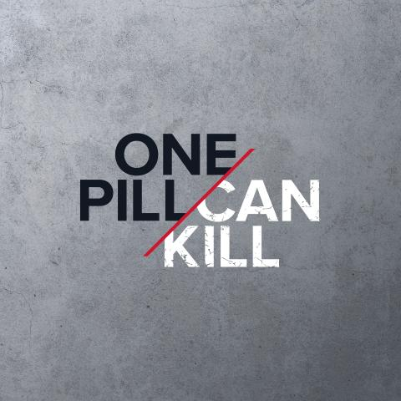
One Pill CAN Kill
In 2021 7,800 adolescents aged 15-19 died from drug overdoses in the U.S. (CDC)
  21.3 Children Per Day
60% of adolescent overdose deaths involved fentanyl poisoning. (CDC)
  12.8 Daily OD’s poisoned with Fentanyl
Overdose death rates among adolescents have TRIPLED between 2019 & 2021. (FDA)
One Pill Can Kill." DEA, U.S. Department of Justice, https://www.dea.gov/onepill.
Notes:
21.3 children between the ages of died everyday in 2021 from drug overdoses in the us, out of those daily 12.8 each day were poisoned with Fentanyl, & those rates have tripled. THIS HITS HOME
ADD CDC REFERENCE – July
MACY:
In 2024 DEA seized more than 60 million fentanyl -laced fake pills and nearly 8,000 pounds of fentanyl powder.
2025 seizures represent over 262 million deadly doses.
Do we like this data more?: https://www.cdc.gov/overdose-prevention/data-research/facts-stats/sudors-dashboard-fatal-overdose-data.html

Slide 18
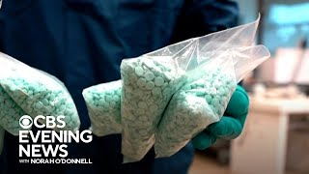
Notes:
Susan – Co-branded with DII logo (Alll Three of us are working on this title – 7/25/24)
Dr. Norman – wanted to use this title
TITLE Dr. Susan wanted: Fentanyl & The Poisoning of Our Children.
Norman Robbie Susan – include some news clippings using this link - https://tv.youtube.com/watch/8cDM3lFUavU?vpp=6gEWCMCd964GENw4Ggs2NXd2N0w3WTVWNIACw
J33rgY%3D&amp;vp=0gEiChYIwJ33rgYQ3DgaCzY1d3Y3TDdZNVY0EgIwAhjAnfeuBg%3D%3D
*I do not have a youtube tv account, but there is a free clip of the pill making process on: https://www.youtube.com/watch?v=jNfSPdwTQ14

Slide 19

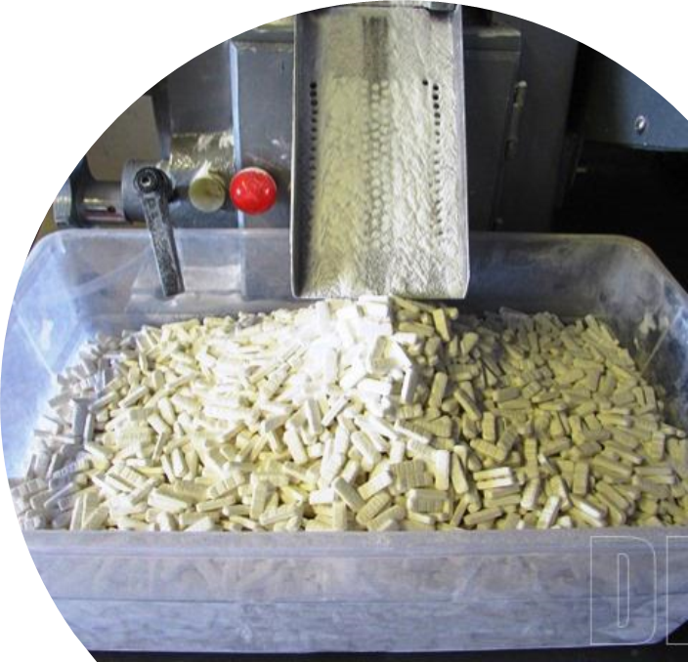
“Counterfeit” Pills
REAL or FAKE?
Using prescription pills that weren’t purchased by a pharmacist is deadly.
Criminal drug networks are mass-producing drugs as legitimate prescriptions pills and selling them as legitimate prescription pills.
“Fake” prescription pills are easily accessible.
Many fake pills are made to look like prescription drugs: Oxycodone – Adderall – Xanax
Notes:
Norman likes this image for Parents (Not sure of the location for flow, but he did want me to add a slide of Fake Vs. Real images. (found on DEA onepillcankill campaign)
WVDII has their own slide too & this would be a good place to use it or add it. Norman enjoys relating to the audience through visuals with knowledge attached.
Would we want to add animation for the bullets?

Slide 20
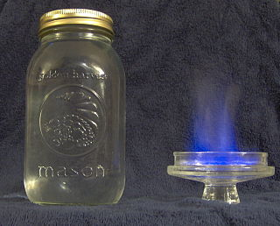
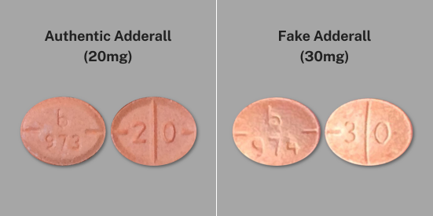
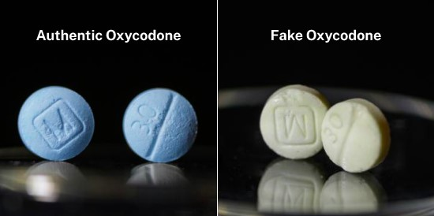
Real or Fake?
One Pill Can Kill." DEA, U.S. Department of Justice, https://www.dea.gov/onepill. Accessed 18 June 2024
Notes:
The reason we are showing moonshine is due to the relationship of contaminated sources (Per Norman in West Virginia – some of the population understands that moonshine can be tainted/blue flame trick (this is anecdotal information but Norman wanted to relate the information for the audience)

Slide 21
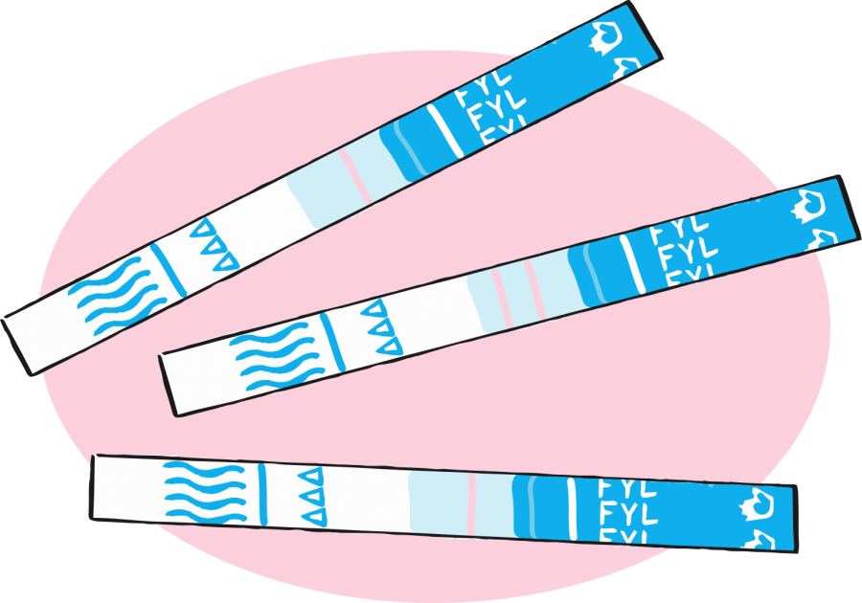
How Can it Be Detected?
Fentanyl test strips, when used properly, have an accuracy rate of 96-100% of finding fentanyl if it is present in a substance. Xylazine test strips have been found to be around 98% effective.
Fentanyl and xylazine test strips are very accurate but they are not perfect. There may still be a chance fentanyl and/or xylazine/other dangerous ingredients are in the products, so practicing other harm reduction measures is always recommended.
https://wisebatch.com/products-2/
Notes:
The reason we are showing moonshine is due to the relationship of contaminated sources (Per Norman in West Virginia – some of the population understands that moonshine can be tainted/blue flame trick (this is anecdotal information but Norman wanted to relate the information for the audience)

Slide 22
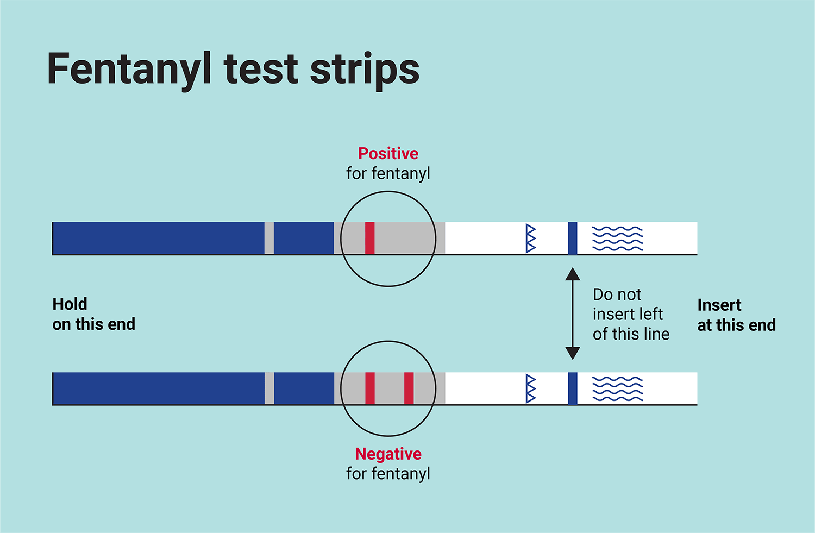
What are Test Strips?
Drug testing strips are small paper strip tests that can detect fentanyl, xylazine, and other harmful ingredients in street drugs.
For both kinds of these tests, only ONE line will appear on the paper if it is positive. For example TWO lines will appear if there is no fentanyl detected. You read a xylazine test strip the same way-one line means no xylazine has been detected.
There may still be a chance fentanyl and/or xylazine/other dangerous ingredients are in the products, so practicing other harm reduction measures is always recommended.
Notes:
The reason we are showing moonshine is due to the relationship of contaminated sources (Per Norman in West Virginia – some of the population understands that moonshine can be tainted/blue flame trick (this is anecdotal information but Norman wanted to relate the information for the audience)
Cole Stiltner: very confused, What is positive and what is negative?

Slide 23
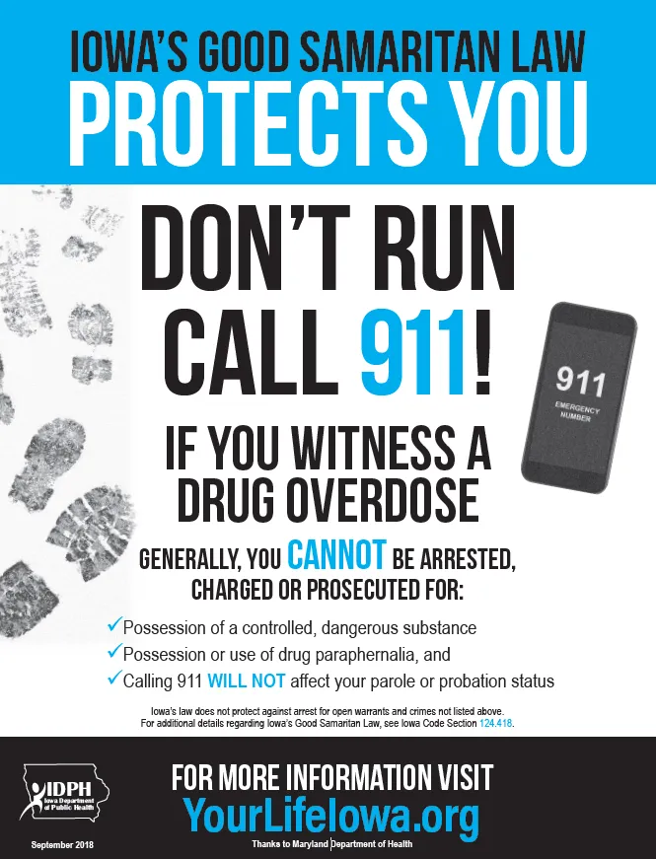
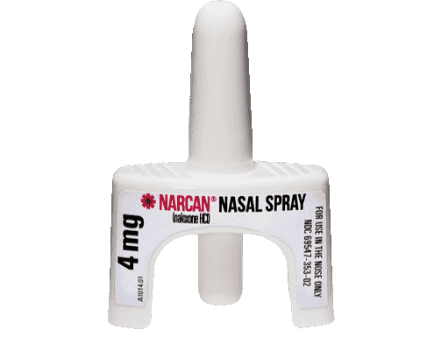
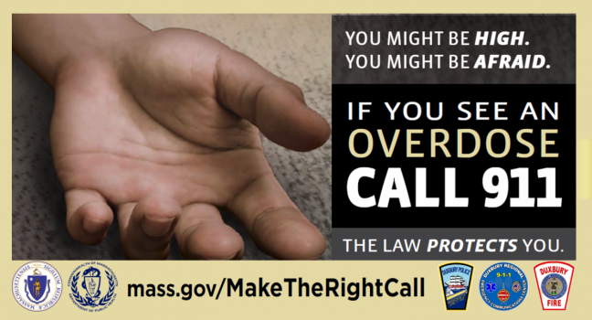
Overdoses.. What can I do?
It is a common misconception that if someone is overdosing and 911 is called that it can result in penalties to any person involved. This is FALSE, Good Samaritan Laws in the United States protect ANYONE who seeks help if they believe they are witnessing a medical emergency, even a suspected drug overdose.
It is important to always call 911 in the event of a medical emergency, even if you or other are intoxicated, underage and/or have illegal drugs. Time is KEY to potentially saving a life. The quicker emergency medical services can treat the victim, the more likely they are to survive.
**The ONLY two states as of May 2024 that do not have Good Samaritan Laws are Wyoming and Kansas.
Notes:
The reason we are showing moonshine is due to the relationship of contaminated sources (Per Norman in West Virginia – some of the population understands that moonshine can be tainted/blue flame trick (this is anecdotal information but Norman wanted to relate the information for the audience)

Slide 24
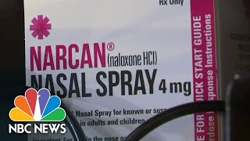
Notes:
Susan – Co-branded with DII logo (Alll Three of us are working on this title – 7/25/24)
Dr. Norman – wanted to use this title
TITLE Dr. Susan wanted: Fentanyl & The Poisoning of Our Children.
Norman Robbie Susan – include some news clippings using this link - https://tv.youtube.com/watch/8cDM3lFUavU?vpp=6gEWCMCd964GENw4Ggs2NXd2N0w3WTVWNIACw
J33rgY%3D&amp;vp=0gEiChYIwJ33rgYQ3DgaCzY1d3Y3TDdZNVY0EgIwAhjAnfeuBg%3D%3D
*I do not have a youtube tv account, but there is a free clip of the pill making process on: https://www.youtube.com/watch?v=jNfSPdwTQ14

Slide 25
What can YOU do?
Be curious, open-minded and connect-you can control!!!!!
Don't think it's not your child
Pay attention to behaviors, especially changes
Educate yourself and share info with others
Talk often, check in and follow- up
Seek help- 988
Notes:
Susan – Co-branded with DII logo (Alll Three of us are working on this title – 7/25/24)
Dr. Norman – wanted to use this title
TITLE Dr. Susan wanted: Fentanyl & The Poisoning of Our Children.
Norman Robbie Susan – include some news clippings using this link - https://tv.youtube.com/watch/8cDM3lFUavU?vpp=6gEWCMCd964GENw4Ggs2NXd2N0w3WTVWNIACw
J33rgY%3D&amp;vp=0gEiChYIwJ33rgYQ3DgaCzY1d3Y3TDdZNVY0EgIwAhjAnfeuBg%3D%3D
*I do not have a youtube tv account, but there is a free clip of the pill making process on: https://www.youtube.com/watch?v=jNfSPdwTQ14

Slide 26
It’s “Fun Until”...
SOMEONE DIES!!!
Drug overdoses are 100% PREVENTABLE.
Make sure you are doing your part.
Notes:
Susan – Co-branded with DII logo (Alll Three of us are working on this title – 7/25/24)
Dr. Norman – wanted to use this title
TITLE Dr. Susan wanted: Fentanyl & The Poisoning of Our Children.
Norman Robbie Susan – include some news clippings using this link - https://tv.youtube.com/watch/8cDM3lFUavU?vpp=6gEWCMCd964GENw4Ggs2NXd2N0w3WTVWNIACw
J33rgY%3D&amp;vp=0gEiChYIwJ33rgYQ3DgaCzY1d3Y3TDdZNVY0EgIwAhjAnfeuBg%3D%3D
*I do not have a youtube tv account, but there is a free clip of the pill making process on: https://www.youtube.com/watch?v=jNfSPdwTQ14

Slide 27
References
Algren D, Monteilh C, Rubin C, et al. Fentanyl-associated fatalities among illicit drug users in Wayne County, Michigan (July 2005-May 2006).Journal Of Medical Toxicology: Official Journal of the American College Of Medical Toxicology [serial online]. March 2013; 9(1):106-115.
Department of Justice, Drug Enforcement Administration, DEA Investigative Reporting, January 2015.
NIDA. 2023, December 13. Reported drug use among adolescents continued to hold below pre-pandemic levels in 2023. Retrieved from https://nida.nih.gov/news-events/news-releases/2023/12/reported-drug-use-among-adolescents-continued-to-hold-below-pre-pandemic-levels-in-2023 on 2024, May 1
Wilson N, Kariisa M, Seth P, Smith H IV, Davis NL. Drug and Opioid-Involved Overdose Deaths — United States, 2017–2018. MMWR Morb Mortal Wkly Rep 2020;69:290–297. DOI: http://dx.doi.org/10.15585/mmwr.mm6911a4
NCHS, National Vital Statistics System. Estimates for 2020 are based on provisional data. Estimates for 2015-2019 are based on final data (available from: https://www.cdc.gov/nchs/nvss/vsrr/drug-overdose-data.htm).
Bergh, Marianne Skov-Skov et al. “Selectivity and sensitivity of urine fentanyl test strips to detect fentanyl analogues in illicit drugs.” The International Journal on Drug Policy. Vol. 90 (2021): https://doi.org/10.1016/j.drugpo.2020.103065
Gaither JR. National Trends in Pediatric Deaths From Fentanyl, 1999-2021. JAMA Pediatr. 2023;177(7):733–735. doi:10.1001/jamapediatrics.2023.0793
O’Jiaku-Okorie, Adaeze, Xianghua Yin, and Christine Lucas. “QuickStats: Rate of Emergency Department Visits for Substance Use Disorders Among Adults Aged ≥18 Years, by Age Group — National Hospital Ambulatory Medical Care Survey, United States, 2018–2019 and 2020–2021.” MMWR. Morbidity and Mortality Weekly Report 72, no. 39 (September 29, 2023): 1073. https://doi.org/10.15585/mmwr.mm7239a6.
Robertson, Elizabeth B., Susan L. David, and Suman A. Rao. “Preventing Drug Use Among Children and Adolescents: A Research-Based Guide for Parents, Educators, and Community Leaders.” 2nd ed. 1997. Reprint, Bethesda, MD: U.S. Department of Health and Human Services, National Institutes of Health, National Institute on Drug Abuse, 2003. https://nida.nih.gov/sites/default/files/preventingdruguse_2.pdf.
Substance Abuse and Mental Health Services Administration. “Drug Abuse Warning Network (DAWN): Findings from Drug-Related Emergency Department Visits, 2022.” Rockville, MD: Center for Behavioral Health Statistics and Quality, Substance Abuse and Mental Health Services Administration, 2023. https://store.samhsa.gov/sites/default/files/pep23-07-03-001.pdf.
Notes:
Parent hand outs

Slide 28
References
Garnett MF, Miniño AM. Drug Overdose Deaths in the United States, 2003-2023. HRB National Drugs Library (Health Research Board). 2024;522(522). doi:https://doi.org/10.15620/cdc/170565
Explore Non-Medical Drug Use - Past Year in West Virginia | AHR. Americashealthrankings.org. Published 2024. Accessed August 25, 2025. https://www.americashealthrankings.org/explore/measures/drug_use/WV
FENTANYL IS FREQUENTLY SUBSTITUTED for or MIXED into OTHER DRUGS, and OFTEN without an INDIVIDUAL KNOWING IT. FENTANYL RESOURCES WHAT IS FENTANYL? Accessed August 25, 2025. https://www.cadca.org/wp-content/uploads/2025/07/NIDA_ABCD_FentanylFlyer.pdf
Opioid Overdose Deaths by Age Group | KFF. KFF. Published August 21, 2025. Accessed August 25, 2025. https://www.kff.org/other/state-indicator/opioid-overdose-deaths-by-age-group/?activeTab=graph&currentTimeframe=0&startTimeframe=4&selectedDistributions=0-24--25-34&selectedRows=%7B%22wrapups%22:%7B%22united-states%22:%7B%7D%7D
West Virginia Office of Drug Control Policy. Data Dashboard. Wv.gov. Published 2020. https://dhhr.wv.gov/office-of-drug-control-policy/datadashboard/Pages/default.aspx
National Institute On Drug Abuse. Reported Use of Most Drugs among Adolescents Remained Low in 2024 | National Institute on Drug Abuse. National Institute on Drug Abuse. Published December 17, 2024. https://nida.nih.gov/news-events/news-releases/2024/12/reported-use-of-most-drugs-among-adolescents-remained-low-in-2024
Baker, Emily A. & Miracle, Tessa L. (2022). College Prescription Drug Study Key Findings Report. College of Pharmacy, The Ohio State University: Columbus, Ohio
Notes:
Parent hand outs

Slide 29
WV Office of Drug Control Policy Data Dashboard
https://dhhr.wv.gov/office-of-drug-control-policy/datadashboard/Pages/default.aspx
Not My Kid
https://notmykid.org/prevention-education/
SAMHSA - 988 Suicide and Crisis Lifeline
https://www.samhsa.gov/find-help/988
Notes:
Hand out for parents

Slide 30
Research for Parents from WVDII
Rex the Rx - Don’t Keep Rex Around™ Medication Safety Program
  https://www.wvdii.org/dkra
WVDII Naloxone (Narcan) Training
  https://wvdii.thinkific.com/courses/naloxone-training
Fentanyl Test Strip Ordering
  https://www.wvdii.org/product-page/fentanyl-test-strips
The ONEbox (TM) is an emergency opioid overdose reversal kit designed to promote safety by assuring that individuals have life-saving, on-demand training when and where they need it.
  https://www.wvdii.org/onebox
Notes:
Parental handouts

